Slide 1
Image Processing INT3404 20
Lecturer: Nguyen Thi Ngoc Diep, Ph.D.
Email: ngocdiep@vnu.edu.vn
Notes:
7 13h00’  13h50’ 10’
8 14h00’  14h50’ 10’
9 15h00’  15h50’

Slide 2
Schedule
Week | Content | Homework
1 | Introduction | Set up environments: Python 3, OpenCV 3, Numpy, Jupyter Notebook
2 | Digital image – Point operations Contrast adjust – Combining images | HW1: adjust gamma to find the best contrast
3 | Histogram - Histogram equalization – Histogram-based image classification | Self-study
4 | Spatial filtering - Template matching | Self-study
5 | Feature extraction Edge, Line, and Texture | Self-study
6 | Morphological operations | HW2: Barcode detection → Require submission as mid-term test
7 | Filtering in the Frequency domain Announcement of Final project topics | Final project registration
8 | Color image processing | HW3: Conversion between color spaces, color image segmentation
9 | Geometric transformations | Self-study
10 | Noise and restoration | Self-study
11 | Compression | Self-study
12 | Final project presentation | Self-study
13 | Final project presentation Class summarization | Self-study

Slide 3
Schedule
Tuần | Nội dung | Yêu cầu đối với sinh viên (ngoài việc đọc tài liệu tham khảo)
1 | Giới thiệu môn học | Cài đặt môi trường: Python 3, OpenCV 3, Numpy, Jupyter Notebook
2 | Ảnh số (Digital image) – Phép toán điểm (Point operations) Làm quen với OpenCV + Python Điều chỉnh độ tương phản (Contrast adjust)– Ghép ảnh (Combining images)
3 | Histogram - Histogram equalization | Làm bài tập 1: điều chỉnh gamma tìm contrast hợp lý
4 | Phép lọc trong không gian điểm ảnh (linear processing filtering) | Thực hành ở nhà
5 | Phép lọc trong không gian điểm ảnh (linear processing filtering) (cont.) Thực hành: Cách tìm filters | Thực hành ở nhà
6 | Thực hành: Ứng dụng của histogram; Tìm ảnh mẫu (Template matching) | Bài tập mid-term
7 | Trích rút đặc trưng của ảnh Cạnh (Edge) và đường (Line) và texture | Thực hành ở nhà
8 | Các phép biến đổi hình thái (Morphological operations) | Làm bài tập 2: tìm barcode
9 | Chuyển đổi không gian – Miền tần số – Phép lọc trên miền tần số Thông báo liên quan đồ án môn học | Đăng ký thực hiện đồ án môn học
10 | Xử lý ảnh màu (Color digital image) | Làm bài tập 3: Chuyển đổi mô hình màu và thực hiện phân vùng
11 | Các phép biến đổi hình học (Geometric transformations) | Thực hành ở nhà
12 | Nhiễu – Mô hình nhiễu – Khôi phục ảnh (Noise and restoration) | Thực hành ở nhà
13 | Nén ảnh (Compression) | Thực hành ở nhà
14 | Hướng dẫn thực hiện đồ án môn học | Trình bày đồ án môn học
15 | Hướng dẫn thực hiện đồ án môn học Tổng kết cuối kỳ | Trình bày đồ án môn học

Slide 4
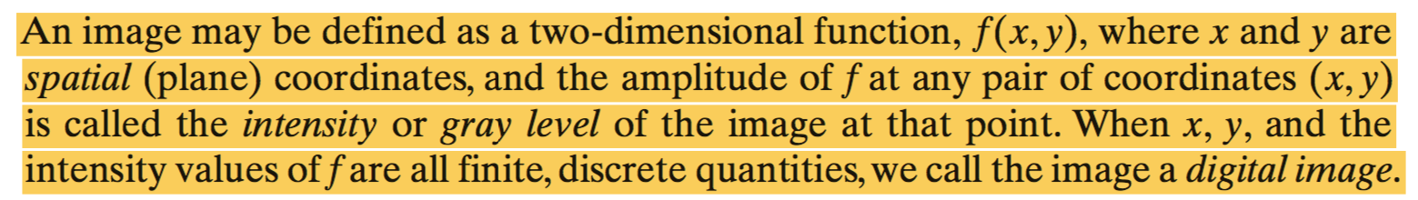
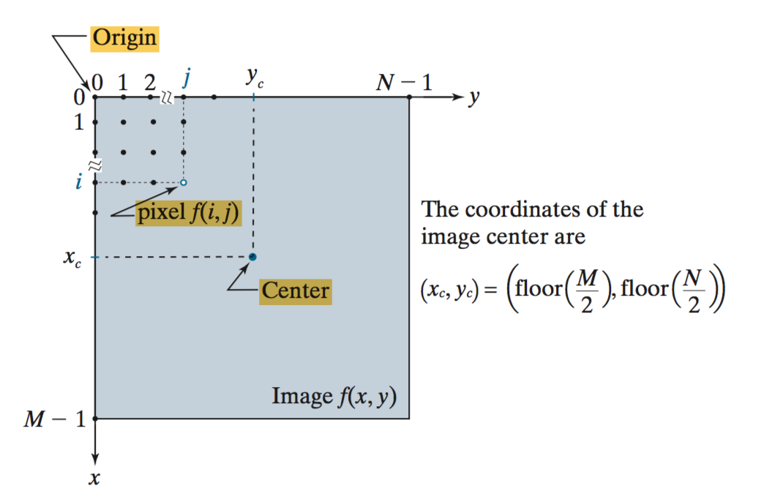
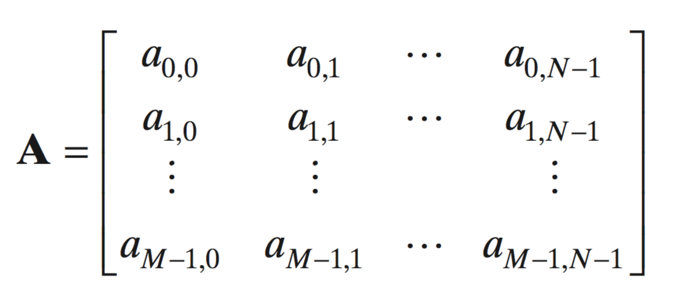
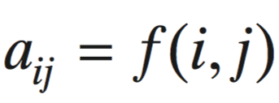
Recall week 2: Digital image

Slide 5
Recall week 2: Quantization levels
Conventional grayscale image has 256 levels
Image credit: Bernd Girod

Slide 6


Recall week 2: Point operations
Aka: Point-processing transformations
Image pixel intensities are transformed into a different set of intensities based on input-output mappings
Gamma transformation
Concept of “Lookup table (LUT) based mapping”
Thresholding
Arithmetic operations
Set and logical operations

Slide 7
Week 3
Histograms

Slide 8
Why study histogram processing?
Histogram manipulation is a fundamental tool in image processing
Histograms:
Simple to compute
Suitable for fast hardware implementations
Popular tool for real-time image processing
Histogram shape is related to image appearance

Slide 9
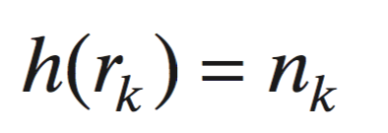
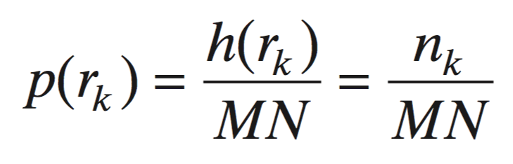
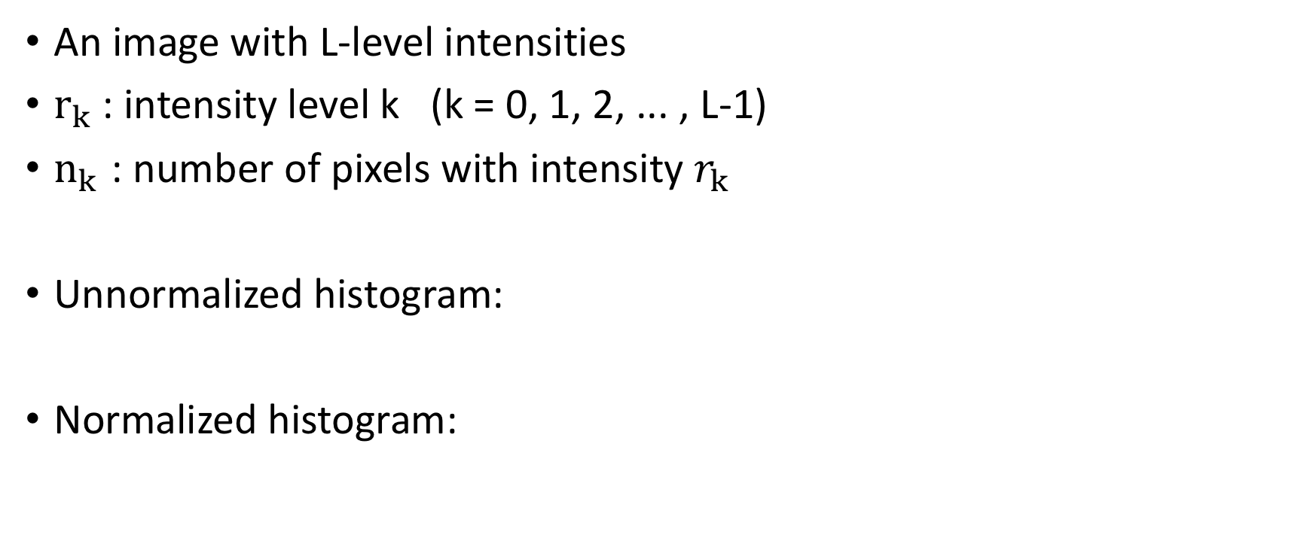
Histogram
An image with L-level intensities
$r_{k}$: intensity level k (k = 0, 1, 2, ... , L-1)
$n_{k}$ : number of pixels with intensity $r_{k}$
Unnormalized histogram:
Normalized histogram:
Normalized histogram:
0
1
256
The subdivisions of the intensity scale are called histogram bins
M: height of image = number of image rows
N: width of image = number of image columns

Slide 10
Histogram shape and image appearance
Notes:
Histogram bins are concentrated on the lower (dark) end of intensity scale
The most populated bins are biased toward the higher end of the scale
Low-contrast (dull image) → narrow histogram located typically toward the middle of the intensity scale
High-contrast image → cover a wide range of the intensity scale

Slide 11
Color image

Slide 12
Histogram equalization
(Cân bằng biểu đồ mức xám)
A special contrast enhancement technique

Slide 13
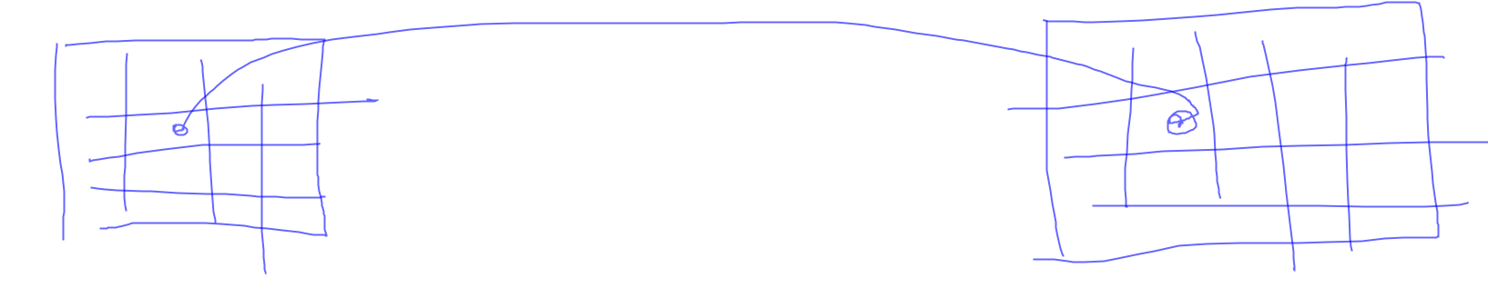
Histogram equalization
Objective: To improve the dynamic range and contrast of an image
Reassigning pixel intensity values such that the resulting image has a (close to) uniform distribution across its entire range of values
Meaning, having a flat intensity histogram
How?

Slide 14
Image integrity
Intensity reassignments must preserve image integrity
Not affect the intensity information structure (intensity ranking) with respect to the pixel geometry
bright ← → dark

Slide 15
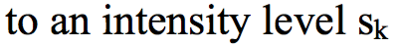
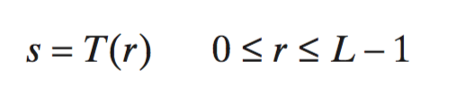
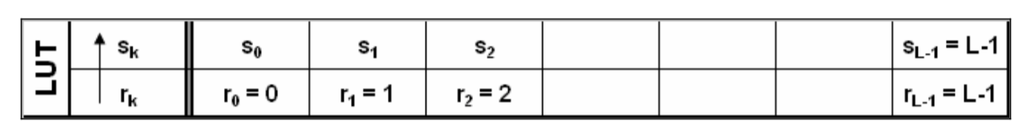
”Pixel geometry”
Map/
Transform
Pixel lookup table
Preserving the image structure by:

Slide 16
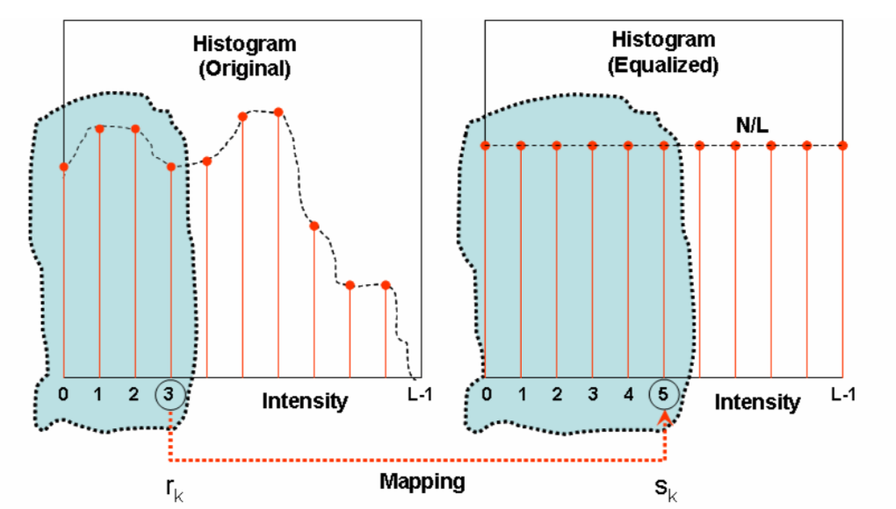
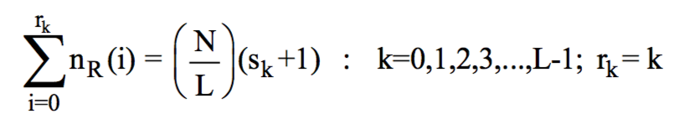
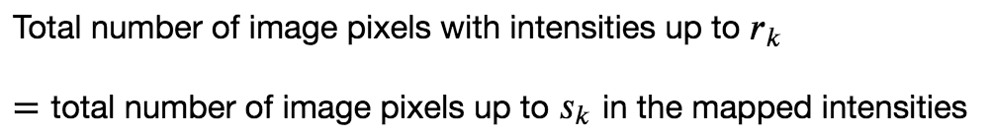
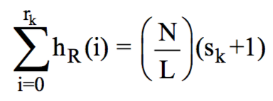
Histogram equalization algorithm
N pixels
L muc xam
N/L
Step 1: 0 -> 4
Sum(rk=0) = sum(sk->4)
If not sum not equal
0 → 3
Rk=1
Sk=3
Or

Slide 17
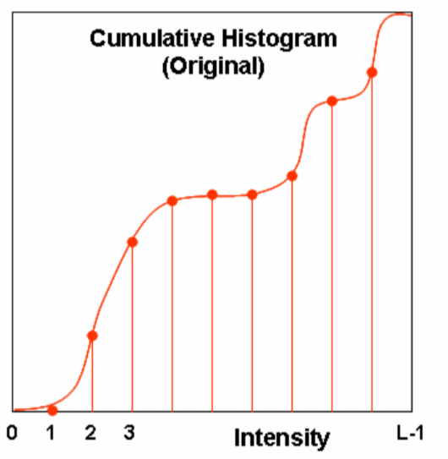
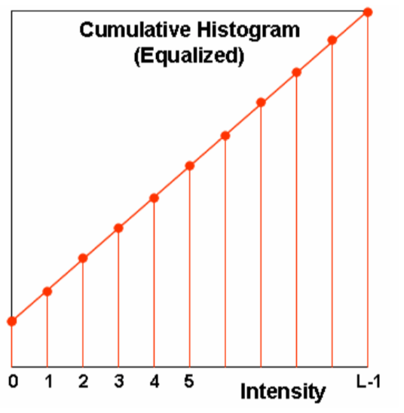
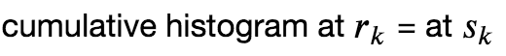
Cumulative Intensity Histogram
C_r(k) = C_s(k)

Slide 18
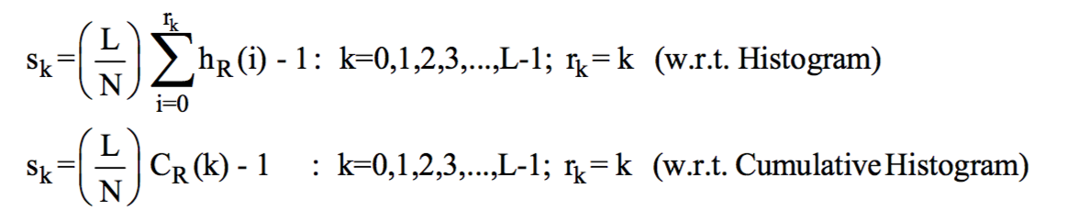
Note
All image pixels with the same intensity in the original image cannot be assigned to different intensities but be mapped to the same new value all together.
→ Perfect histogram equalization will not be possible for digital images due to discrete values

Slide 19


Characteristics of histogram equalization
Monotonically increasing function

Slide 20
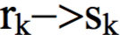
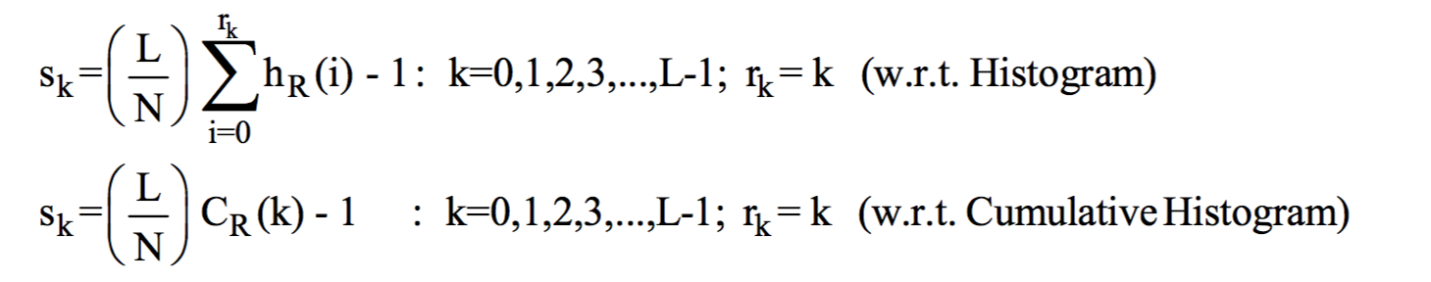
Steps of Histogram equalization
Compute the intensity histogram and/or cumulative intensity histogram of the original image
Compute the lookup table
Transform the original image using the lookup table

Slide 21
HE example
Source: Gonzalez et al.

Slide 23
Implementation
Refer to source code

Slide 24
Local histogram equalization

Slide 25
Local histogram processing
Global histogram processing: a transformation function modifies the intensity distribution of an entire image
Suitable for overall enhancement
Local histogram processing: modifies intensity distribution of pixel neighborhoods
To enhance details over small areas in an image
Two approaches:
Non-overlapping regions → can produce an undesirable “blocky” effect
Overlapping → more computation

Slide 26
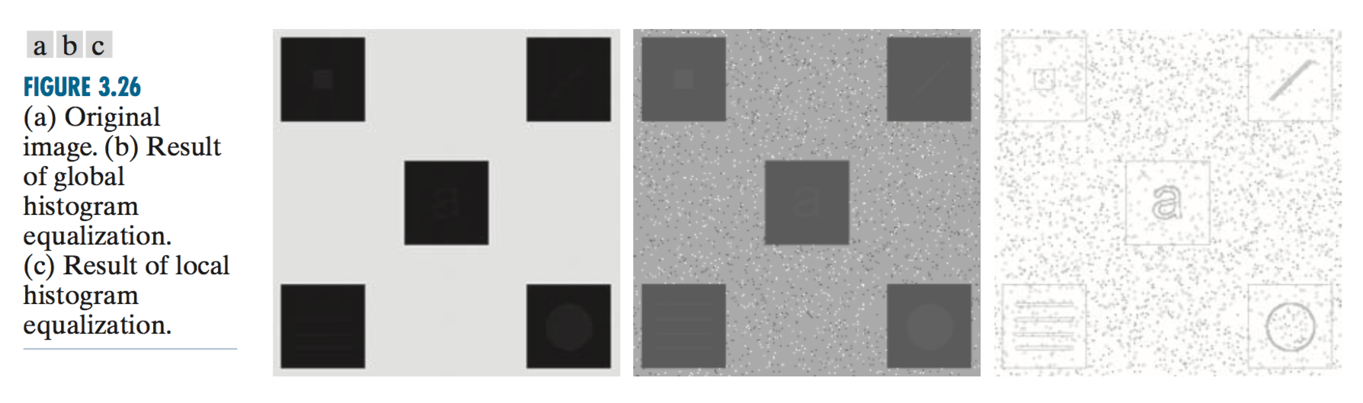
Example of local histogram equalization
Using a neighborhood of size 3x3

Slide 27
Contrast Limited Adaptive Histogram Equalization (CLAHE)
Image is divided into small blocks called "tiles" (e.g., 8x8 pixels).
Each block is histogram equalized as usual.
In a small area, histogram would confine to a small region (unless there is noise).
If noise is there, it will be amplified --> to avoid this, *contrast limiting is applied.
If any histogram bin is above the specified contrast limit (e.g., 40), those pixels are clipped and distributed uniformly to other bins before applying histogram equalization. After equalization, to remove artifacts in tile borders, bilinear interpolation is applied.
Ref: - Campos, Gabriel Fillipe Centini, et al. "Machine learning hyperparameter selection for Contrast Limited Adaptive Histogram Equalization." EURASIP Journal on Image and Video Processing 2019.1 (2019): 59.
- https://docs.opencv.org/master/d2/d74/tutorial_js_histogram_equalization.html

Slide 28
Histogram matching
As known as “Histogram Specification”

Slide 29
Histogram matching
Histogram Equalization
A transformation function that generates an output image with a uniform histogram
Histogram Matching
A transformation function that generates an output image with a specified histogram
template
source

Slide 30
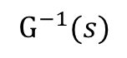
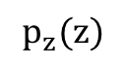
Histogram matching
Histogram equalization
T(r)
source
$$p_{z}(z)$$
$$G^{−1}(s)$$
template
z
G(z)
Histogram equalization

Slide 31
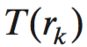
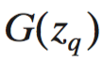
Steps of histogram matching
Compute the histogram of the input image and do the histogram equalization from r_{k} to s_{k}
Compute histogram of the template image and do the histogram equalization from z_{q} to s’_{q}
For each s_{k}, find z_{q} such that G(z_{q}) is close to s_{k}
Do the transformation
r → s_{k} → z_{q}

Slide 32
Histogram matching example
z
G
G⁻¹

Slide 33
Image retrieval using histogram

Slide 34
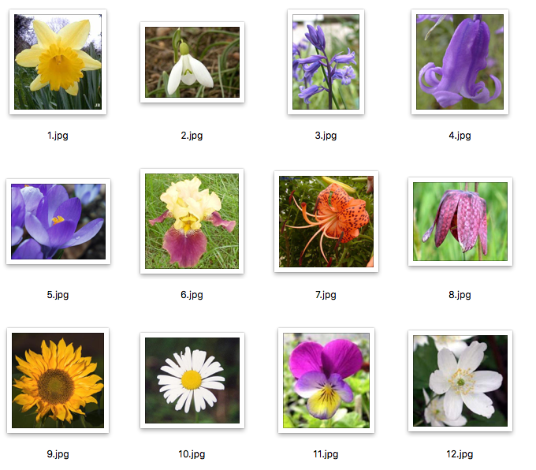
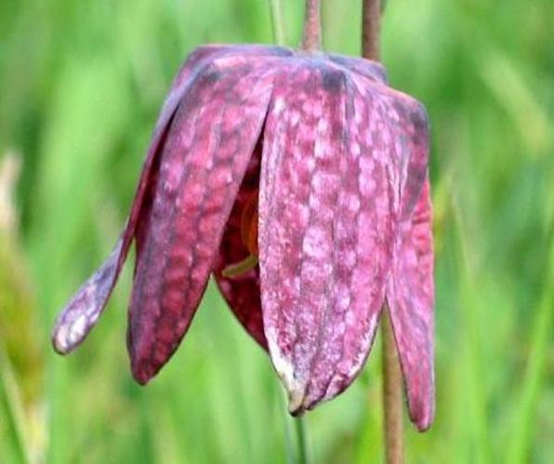
Giới thiệu bài toán
Tìm ảnh trong tập dữ liệu ảnh gần giống với ảnh đầu vào nhất
Dataset
Input
→ Bài toán sắp xếp

Slide 35
fun
Computation space
Sorting
Retrieval/search
Clustering
classification

Slide 36
Image retrieval algorithm
For each image in the dataset D
Calculate the channel-wise histogram
Stack histograms to make 1D vector (as feature vector)
Given an input image, do step 1 to obtain the feature vector (q)
Do vector similarity calculation between vector q and vectors in D
Return the corresponding images which have the most similar feature vectors to q

Slide 37
Implementation
Refer to source code

